Slide 1

Cardiovascular Risk Prediction
By Bushra Abukarn
Model used: binary logistic, probit, and cloglog

Slide 2
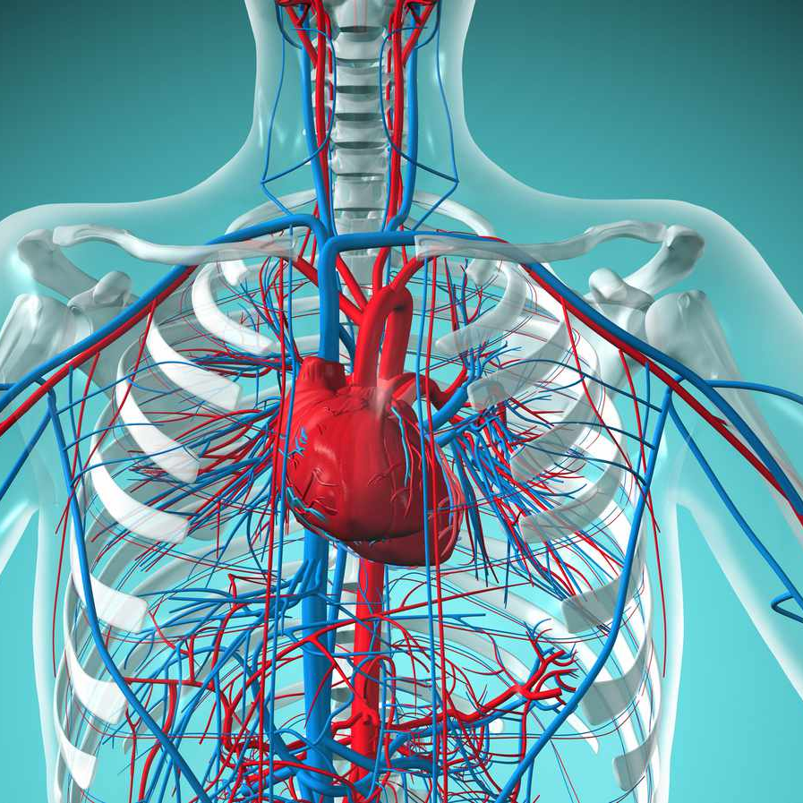
The reason for choosing to talk about this topic: Cardiovascular diseases encompass a range of disorders that affect the heart and blood vessels. Globally, Cardiovascular diseases are the leading cause of death, taking an estimated 17.9 million lives each year, as reported by the World Health Organization. Numerous factors contribute to the risk of developing cardiovascular diseases. Analyzing the provided data through a regression analysis model allows us to identify which factors have the most significant impact. Furthermore, regression analysis stands out as the most frequently used technique in machine learning. According to the National Library of Medicine, machine learning significantly improves the accuracy of predicting cardiovascular risk.

Slide 3
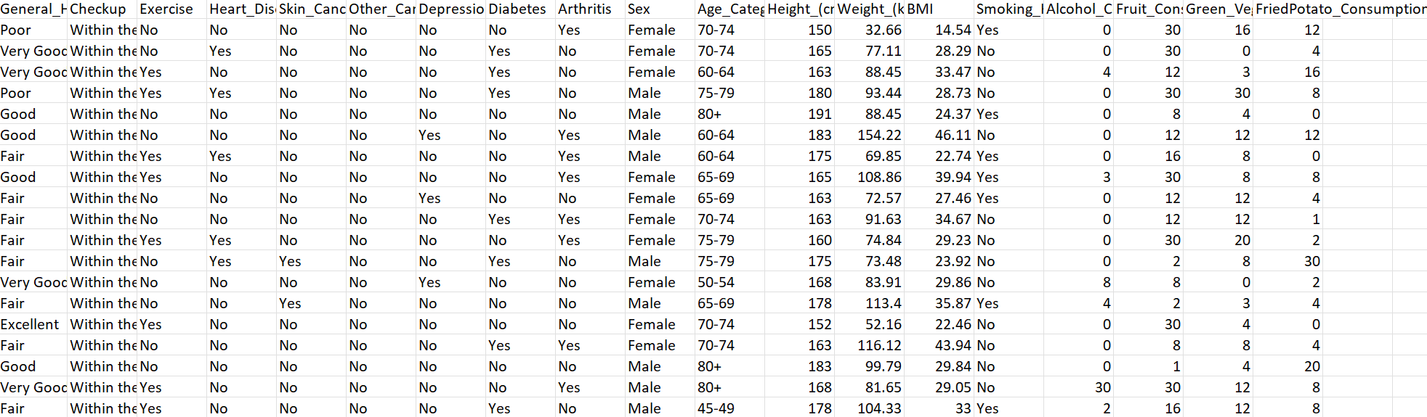
Data set The predictors: Exercise, Depression, Sex, Age Category, BMI, Smoking History, and Alcohol Consumption

Slide 4
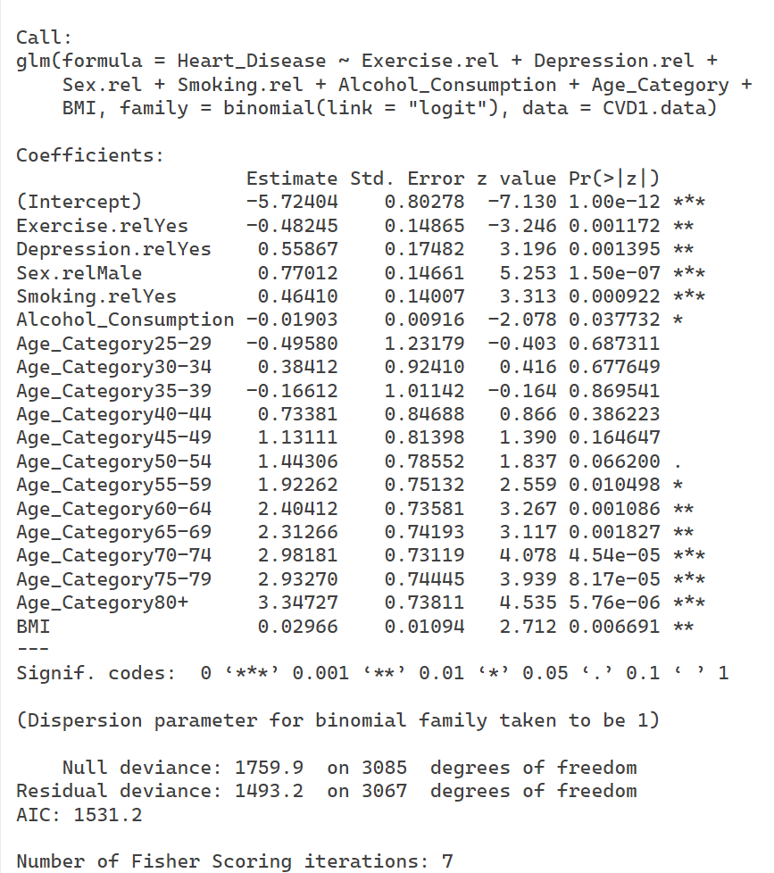
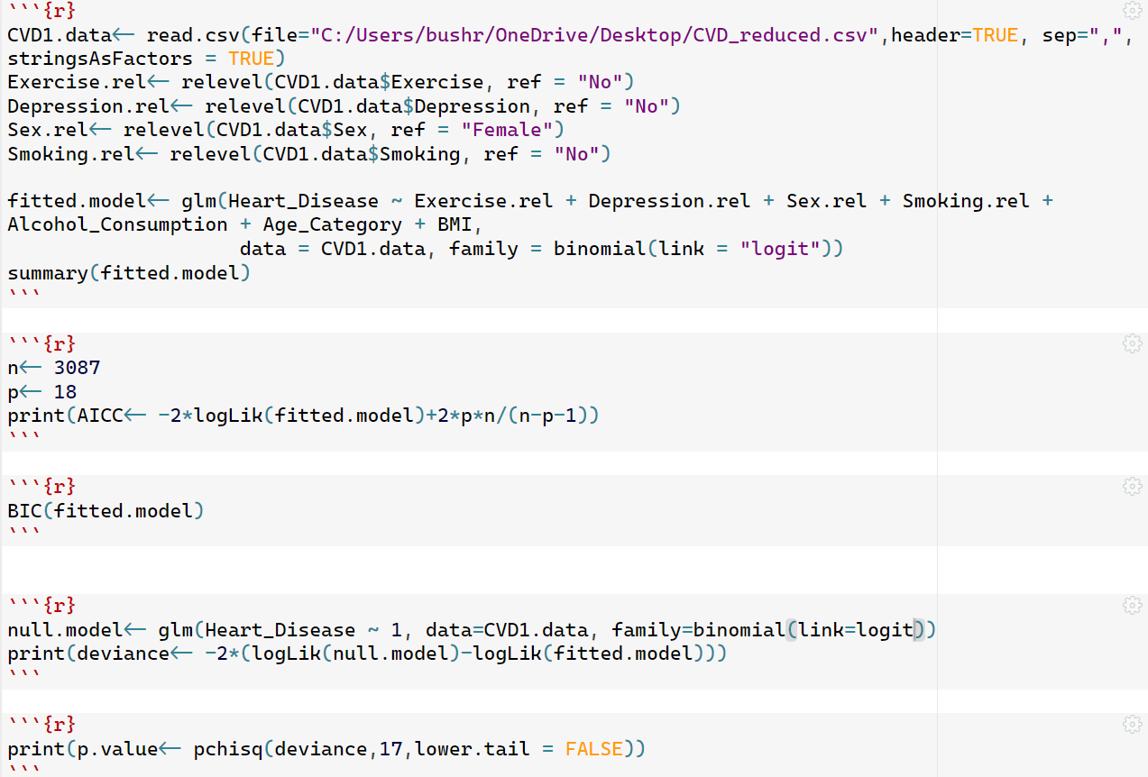
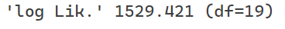
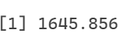
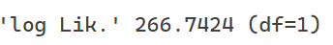
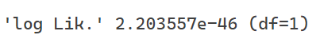
R code & output for the logistic model:

Slide 5
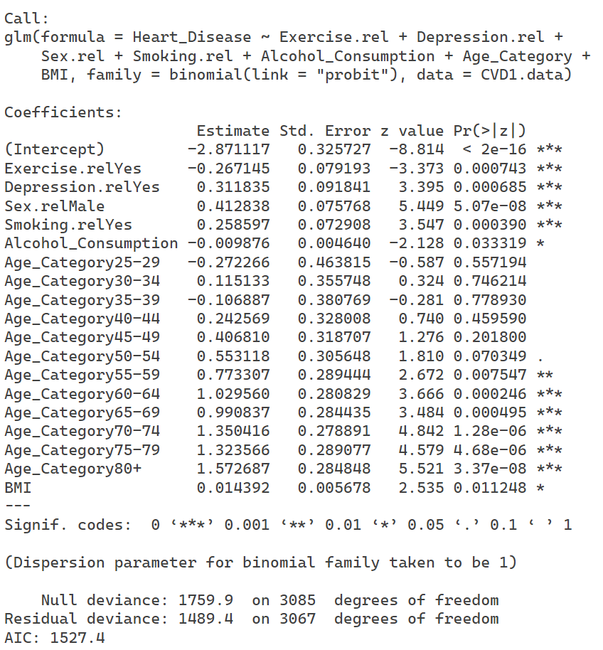



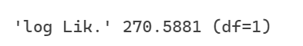
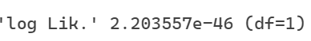
R code & output for the probit model:

Slide 6
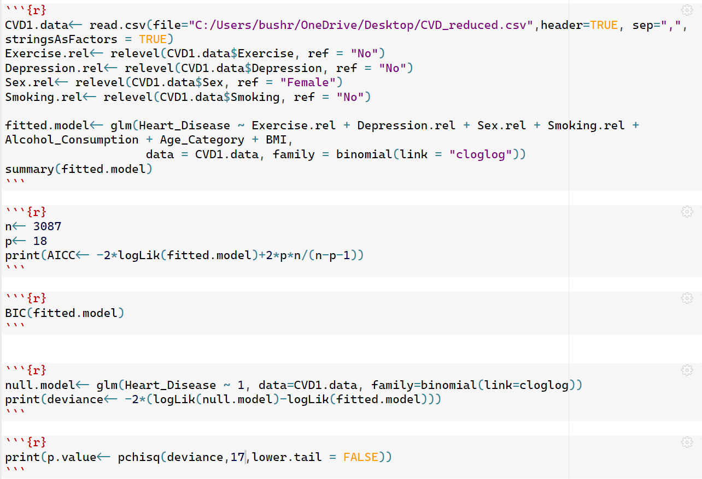
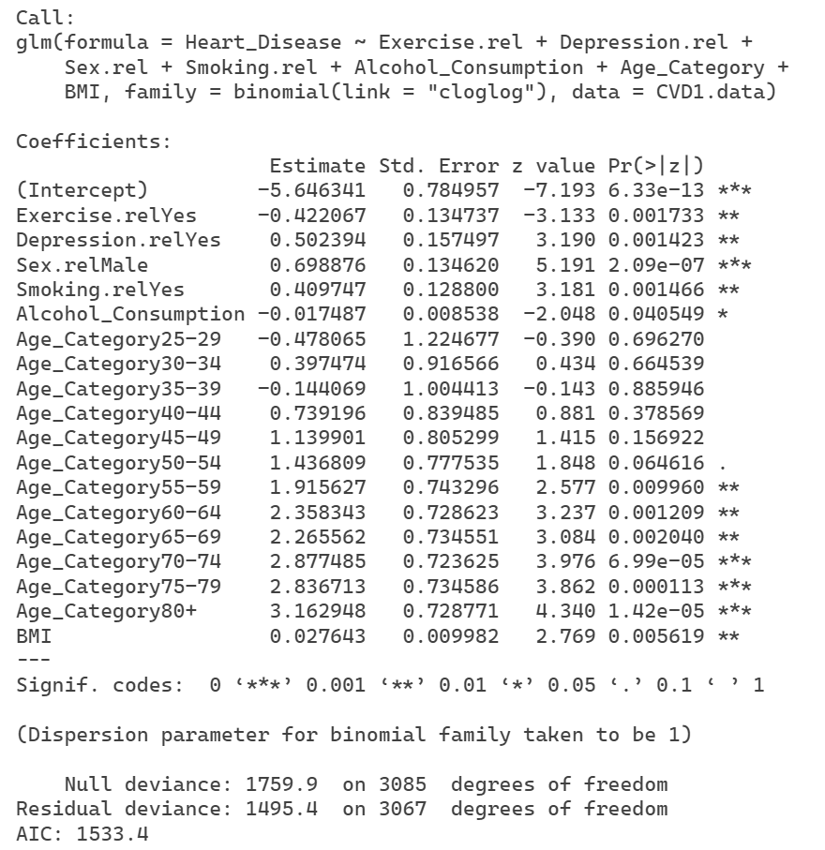
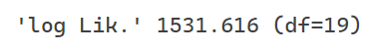

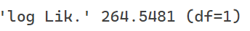

R code & output for the complementary log-log model:

Slide 7
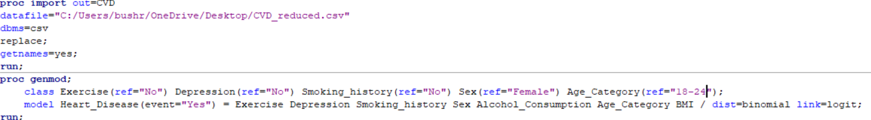
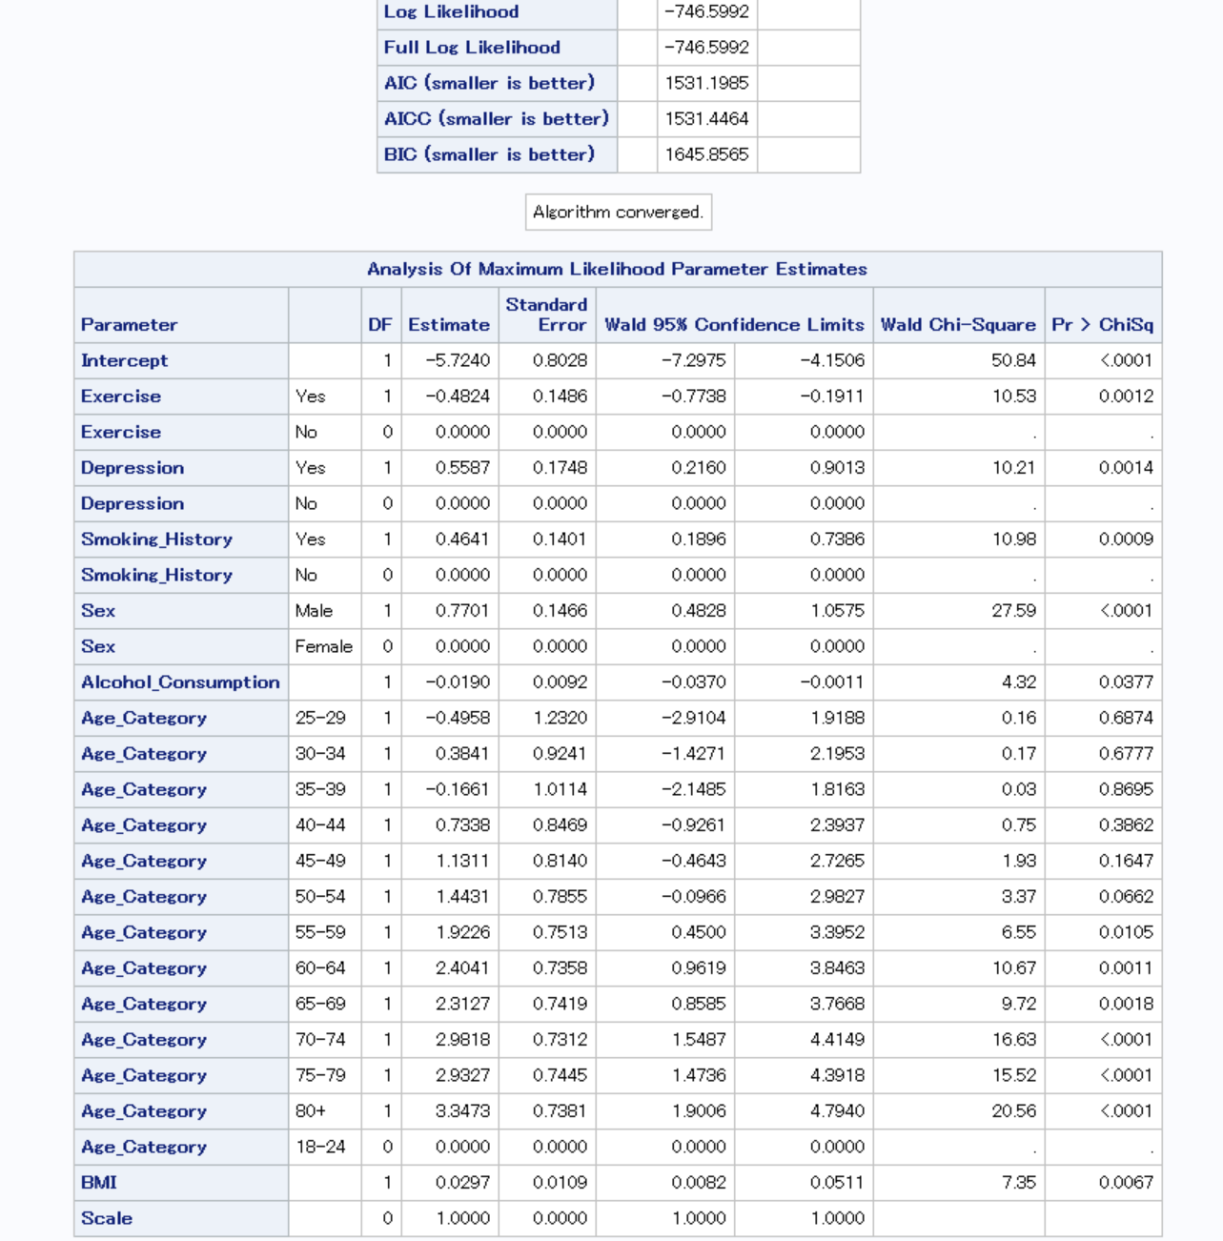


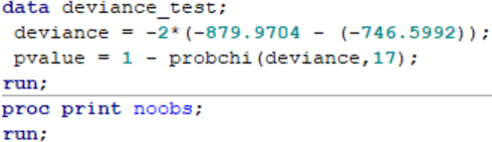

SAS code & output for the logistic model:

Slide 8
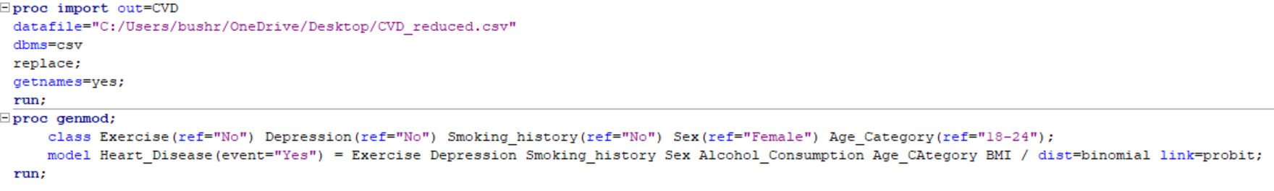
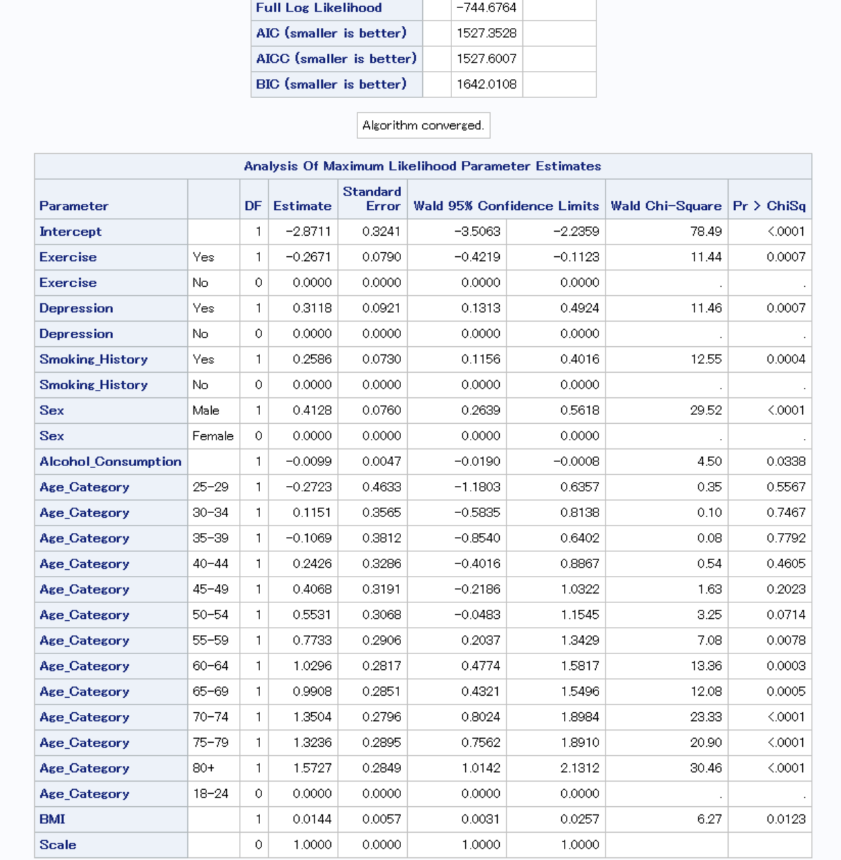
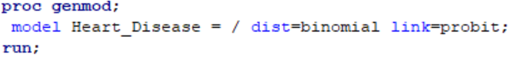
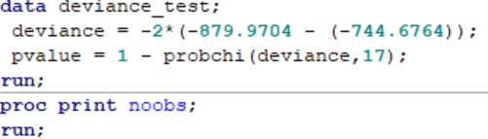
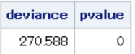
SAS code & output for the probit model:

Slide 9
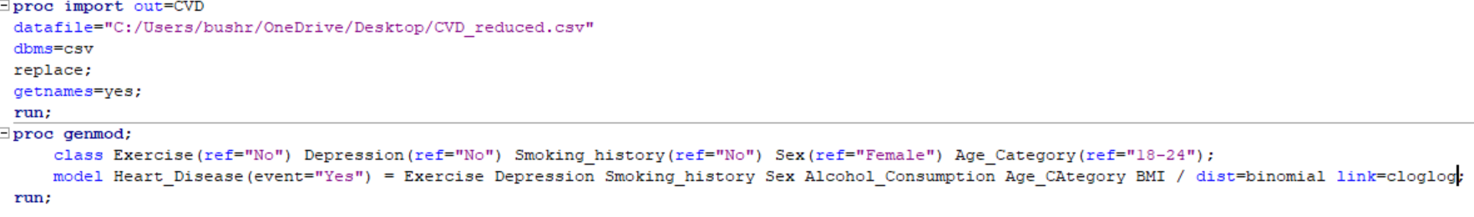
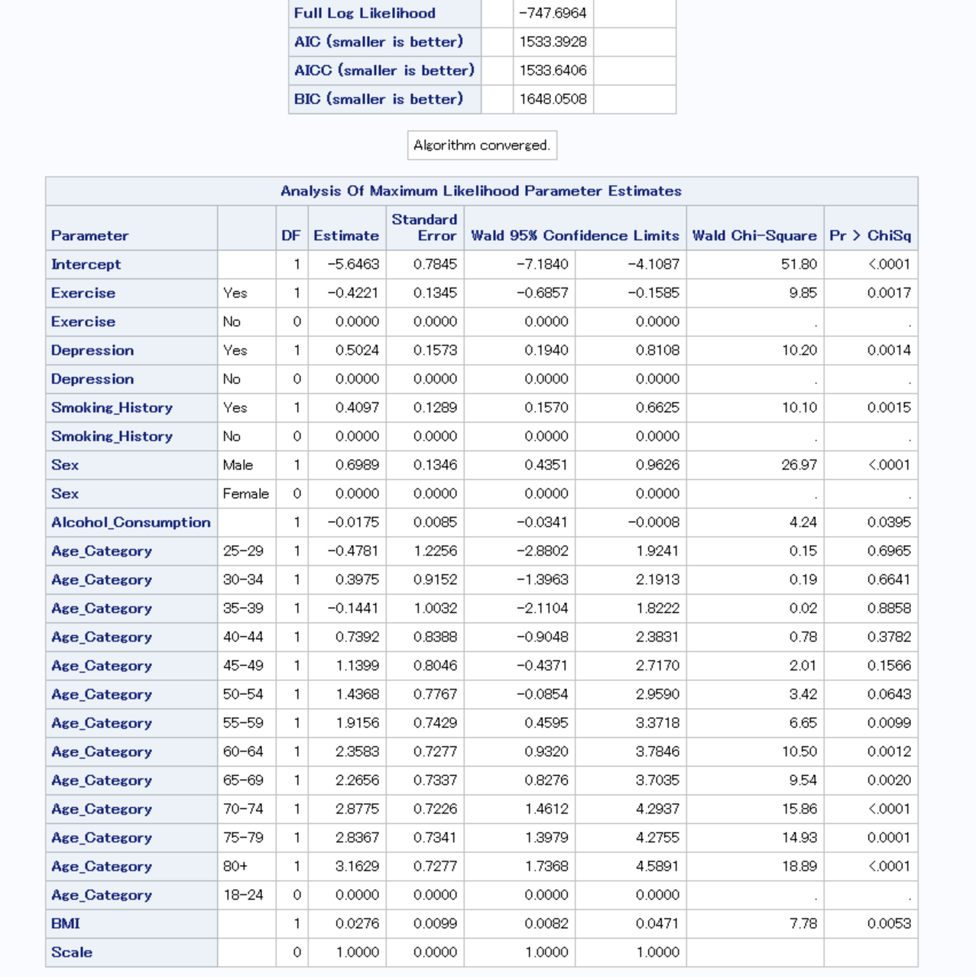
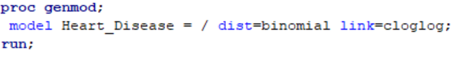
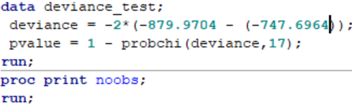
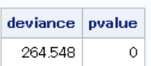
SAS code & output for the complementary log-log model:

Slide 10

The probit model has smaller values in all three criteria. Thus, the probit model has the best fitted model.
 | Logistic | Probit | Cloglog
AIC | 1531.2 | 1527.4 | 1533.616
BIC | 1529.421 | 1525.576 | 1531.616
AICc | 1645.856 | 1642.011 | 1648.051

Slide 11


The probit fitted model:
Φ^-1(π) = -2.871117 -.267145 Exercise + .3113835 Depression + .412838 Male + .258597 Smoking - .009876 Alcohol – 2.72266 (25-29 years old) + .115133 (30-34 years old) - .106887 (35-39 years old) + .242569 (40-44 years old) + .406810 (45-49 years old) + .553118 (50-54 years old) + .773307 (55-59 years old) + 1.029560 (60-64 years old) + .990837 (65-69 years old) + 1.350416 (70-74 years old) + 1.323566 (75-79 years old) + 1.572687 (80+ years old) + .014392 BMI.
Interpretation of Estimated Regression Coefficient:
Males have a 0.412838 higher z-score of estimated probability of developing cardiovascular disease than females. Engaging in regular exercise decreases the z-score by 0.267145. Conversely, depression raises the z- score by 0.311835, and smoking increases the z-score by 0.258597. Besides, young people have a lower z-score than the elderly. Additionally, for each unit increase in BMI, the estimated z-score rises by 0.014392.

Slide 12
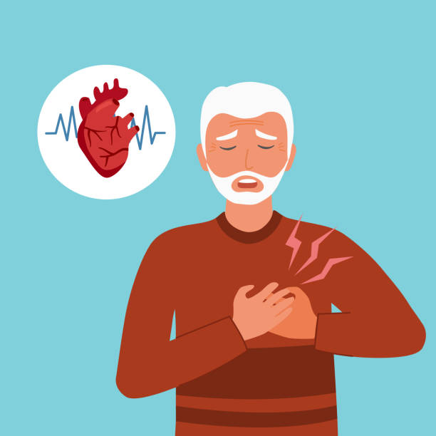
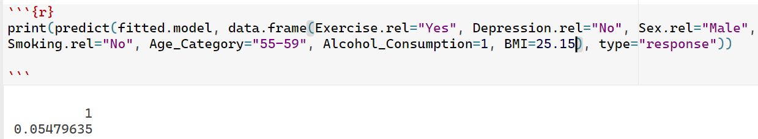
Fitted model for a prediction response: The predicted response probability of developing a cardiovascular disease to a 55-year-old man who is happy, exercises regularly and does not smoke, and drinks rarely is .05479635, around 5.5%. This suggests that the elderly can reduce their risk of this disease by adopting a healthy lifestyle.

Slide 13

Thank you to my dear Professor Olga and my wonderful classmates, I appreciate your time. Good luck to everybody.

